Slide 1
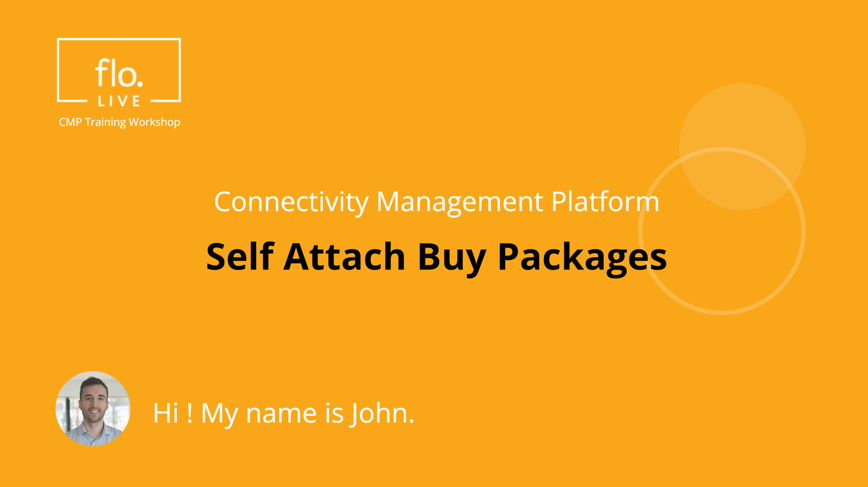
Notes:
Hi, My name is John and welcome to the CMP Training Workshop

Slide 2
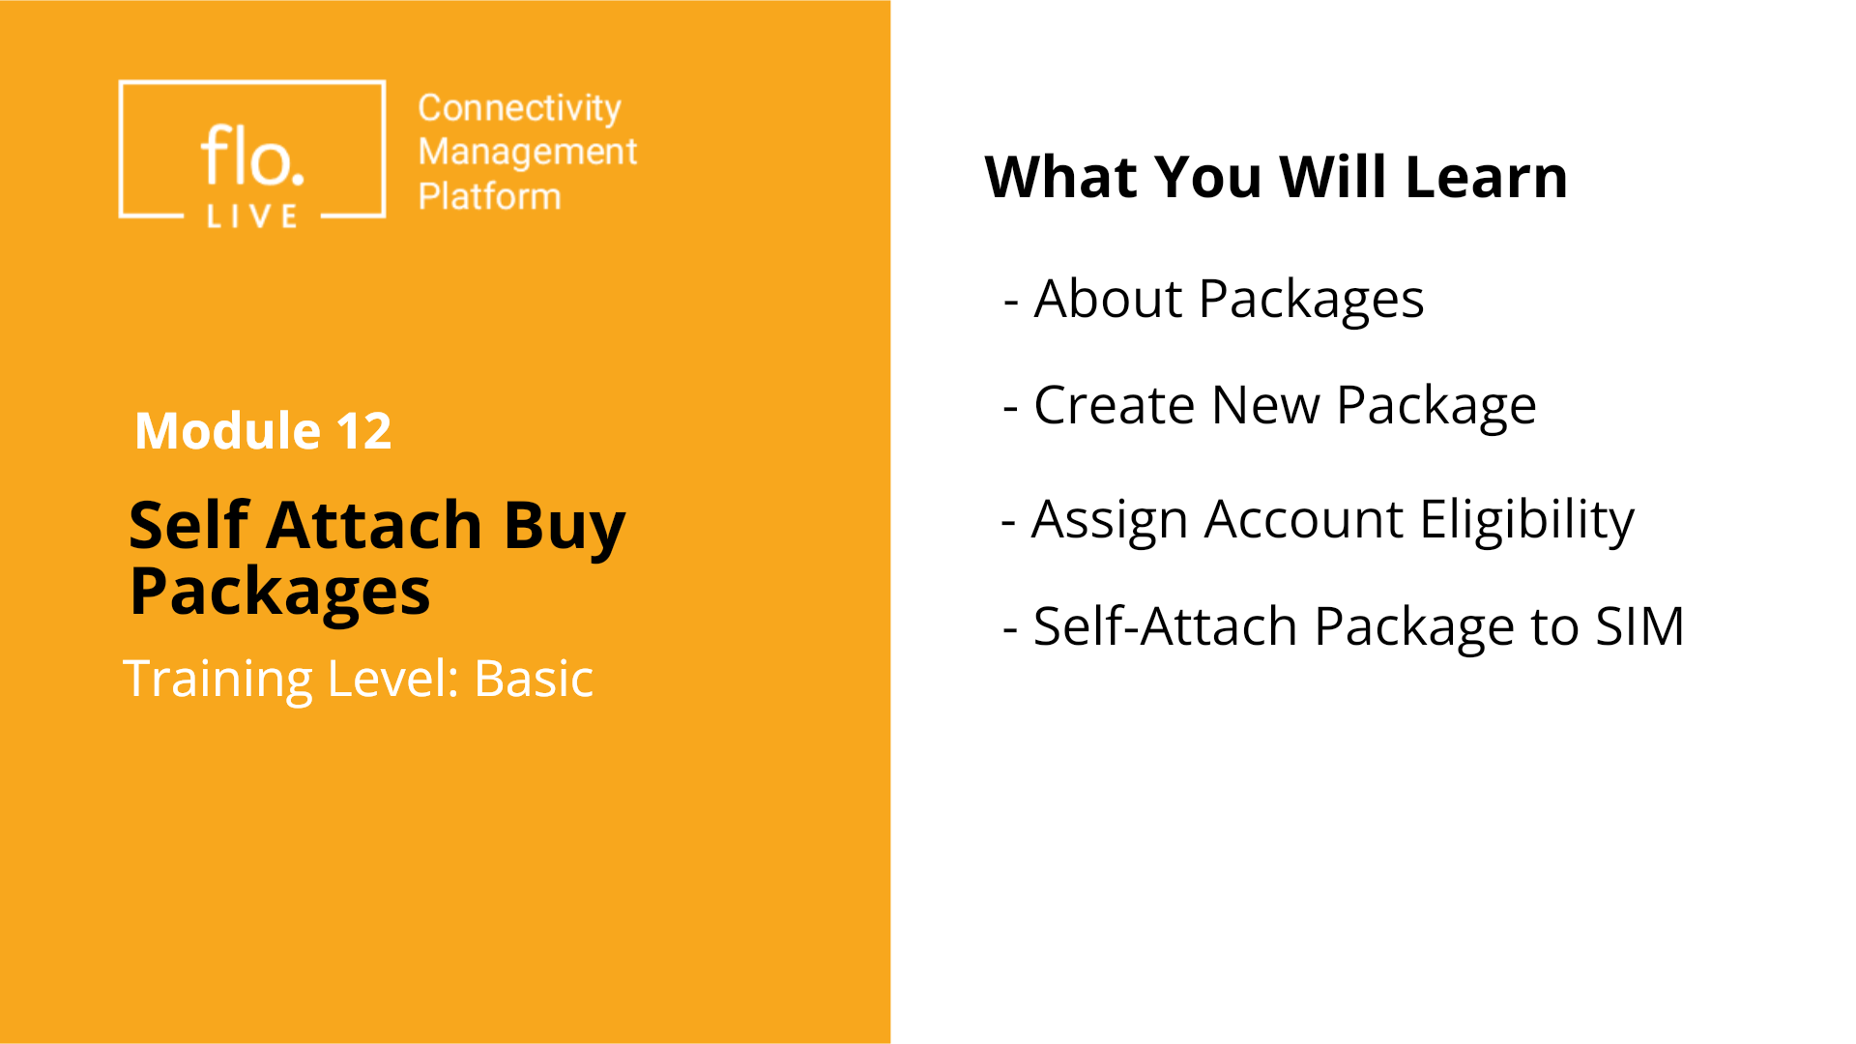
Notes:
In this tutorial, we will explore how to create Packages that include different types of plans. You will learn how to add plans to a new package, and assign eligibility to your sub-accounts. We will also learn how to enable the Self-Attach feature so that sub-accounts can manage their SIM cards by attaching or detaching a Buy Package

Slide 3
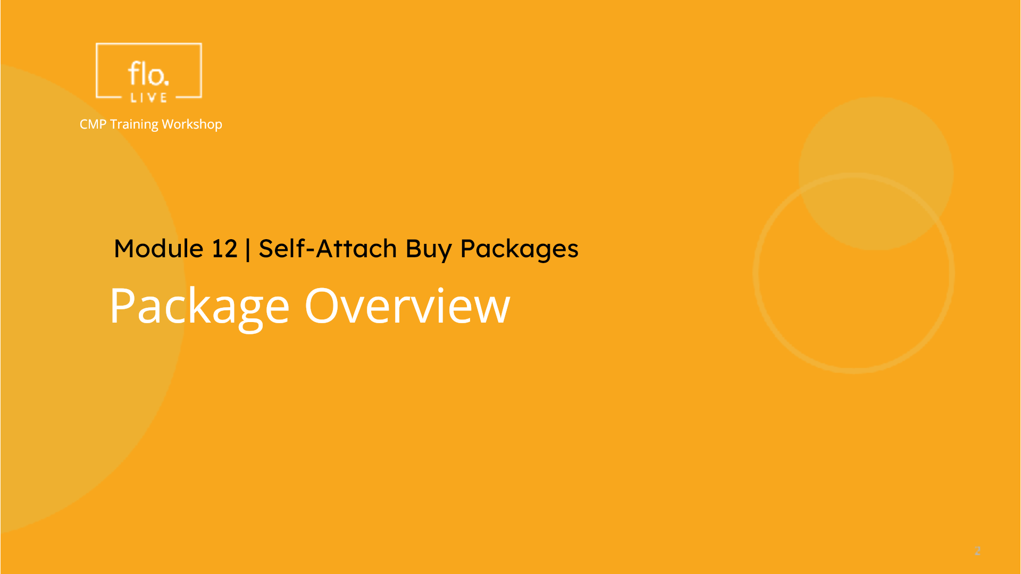
Notes:
We begin this tutorial with a quick tour of the Package module.

Slide 4
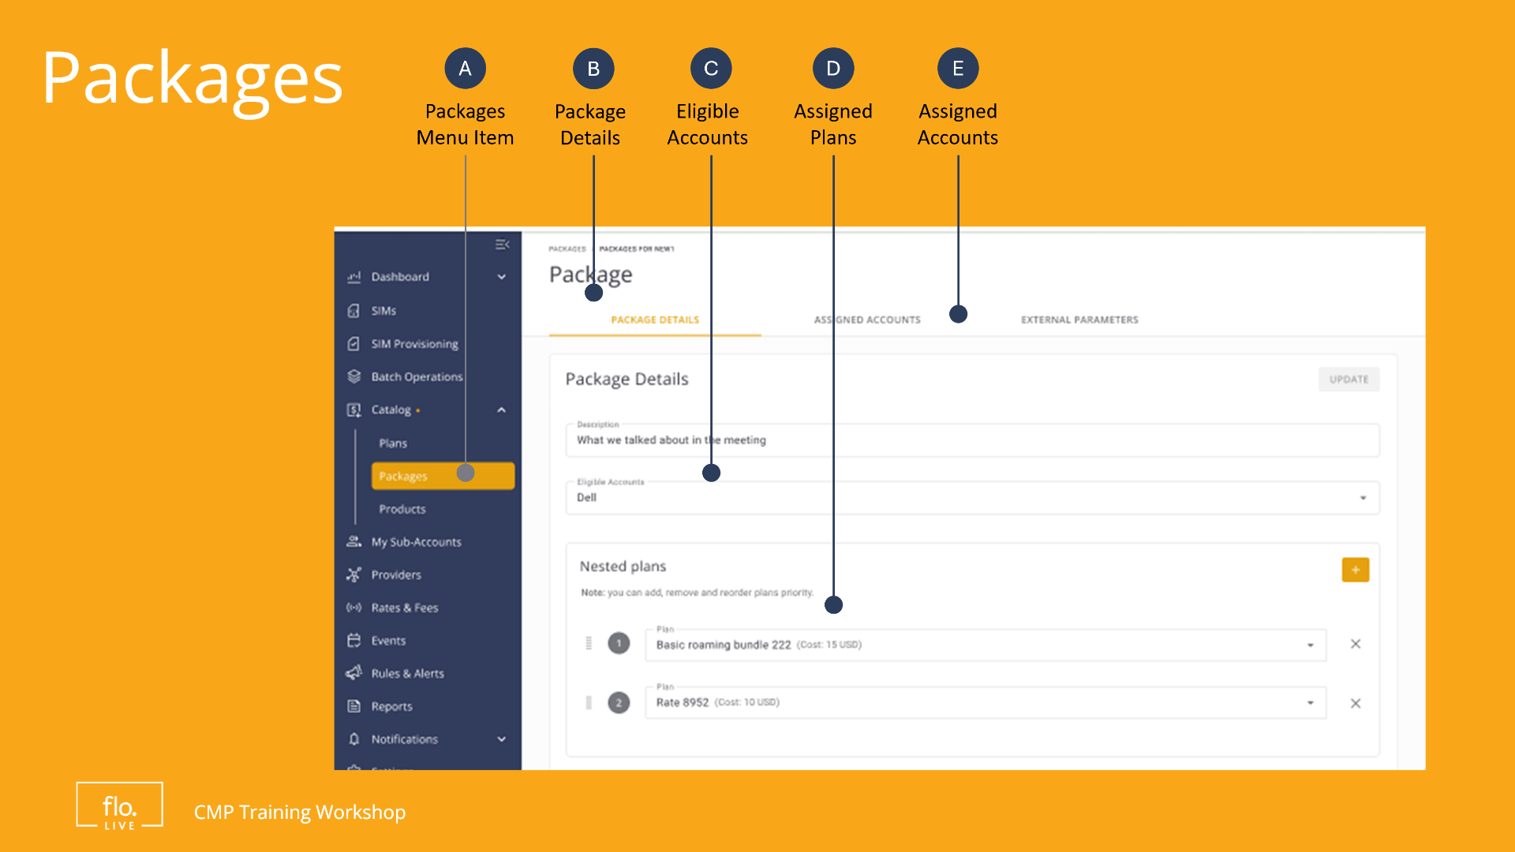
Notes:
A Package, is simply a container that includes one or more plans. Each package may contain different types of plans such as Regular Type Plans, and Pool Plans. A Hybrid Package contains a mix of both Regular and Pool Plans.
A package can be attached to a single sub-account, multiple sub-accounts or to all sub-accounts. There are no limitations on the number of packages you can create.

Slide 5
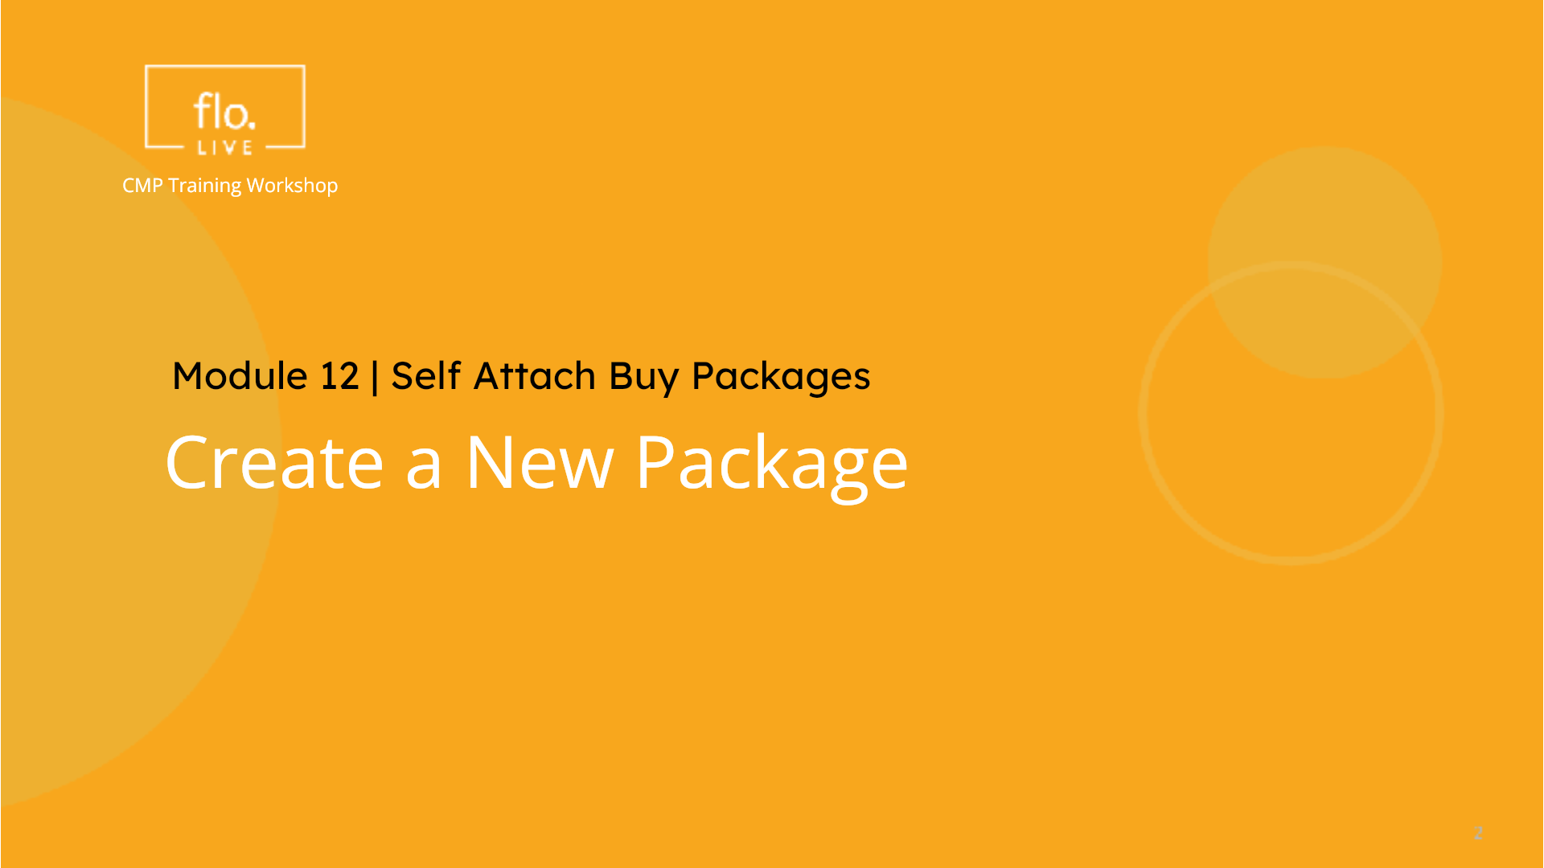
Notes:
Lets learn how to create a new package in the CMP portal.

Slide 6
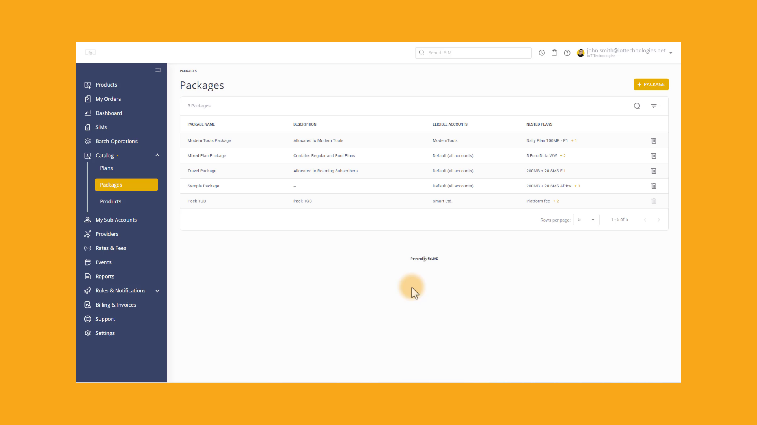
Notes:
Select Packages on the sidebar menu to display a list of existing packages.
Each package contains the Package Name, a short description, the eligible sub-accounts and the assigned plans included in the package.
To Create a New Package, click the Plus Package button.
First, you need to type a Name for the new package. Then add a short Description for the new package. Now select the sub-accounts that will be eligible to use the package.
Then go to the Nested Plans and select one or more Plans to include in your package. . When you have selected the plans to include in your package, you can drag a selected plan up and down to reorder the plan priority.
Finally,click the create button to save the package.

Slide 7
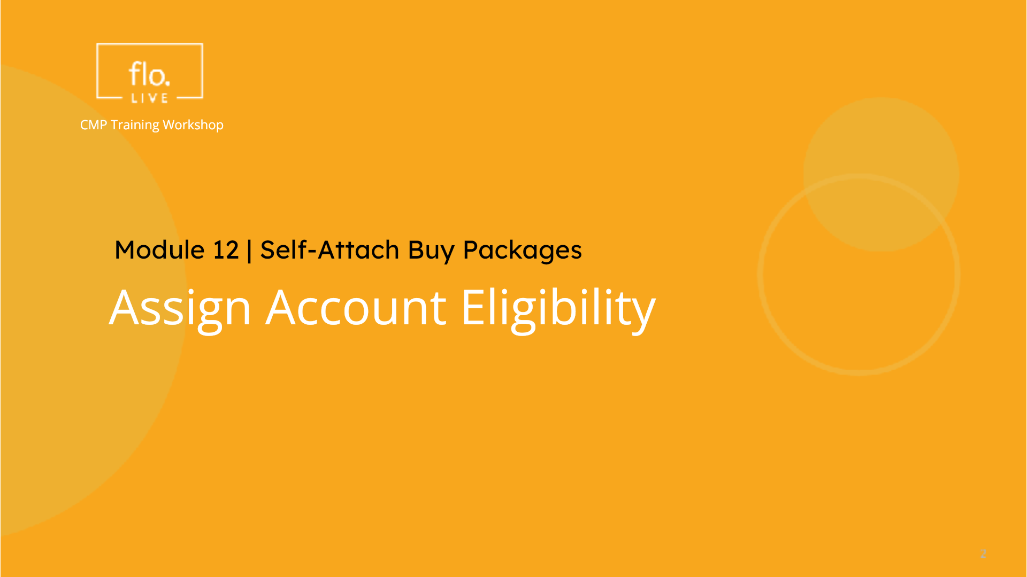
Notes:
Now that you know how to create a package, you need to define which sub-accounts are eligible to use the packages

Slide 8
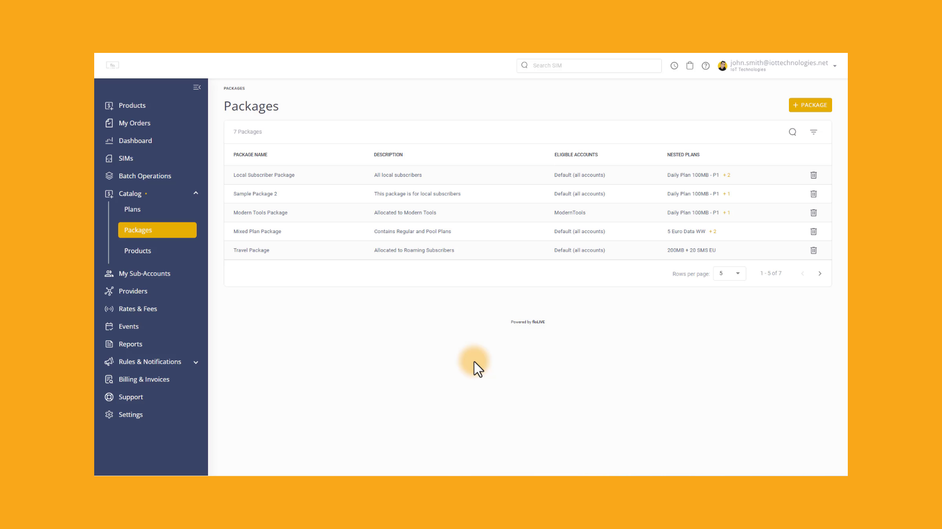
Notes:
To enable the Self-Attach Buy Package option you need to configure the Sub-Account settings. Go to My Sub-Accounts, and click a Sub-Account from the list. Scroll the Sub-Account Details page , and check the "Allow Customer to Attach SIMs to Buy Plan/Package" option.
Click Update to save sub-account settings. Thats it!! You are done!. The selected sub-account is now eligible to use the Self-Attach option.

Slide 9
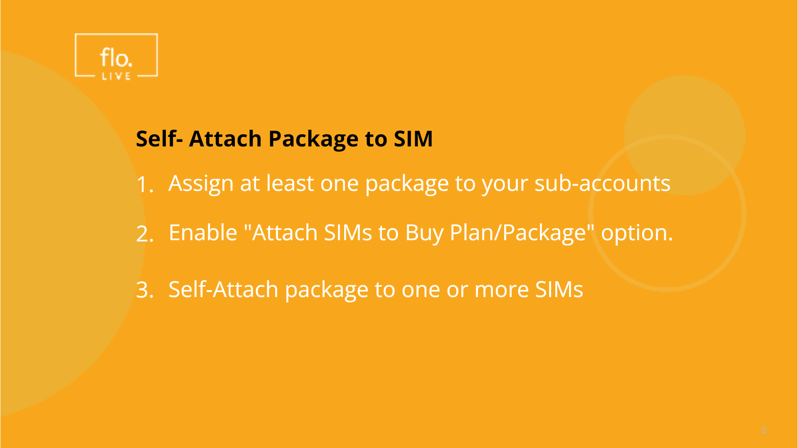
Notes:
In the first part of this tutorial you learnt how to create a new package and assign it to your sub-accounts. In the second part, you learnt how to assign eligibility to one or more sub-accounts. Now your sub-accounts are ready to attach a package to their SIM cards.

Slide 10
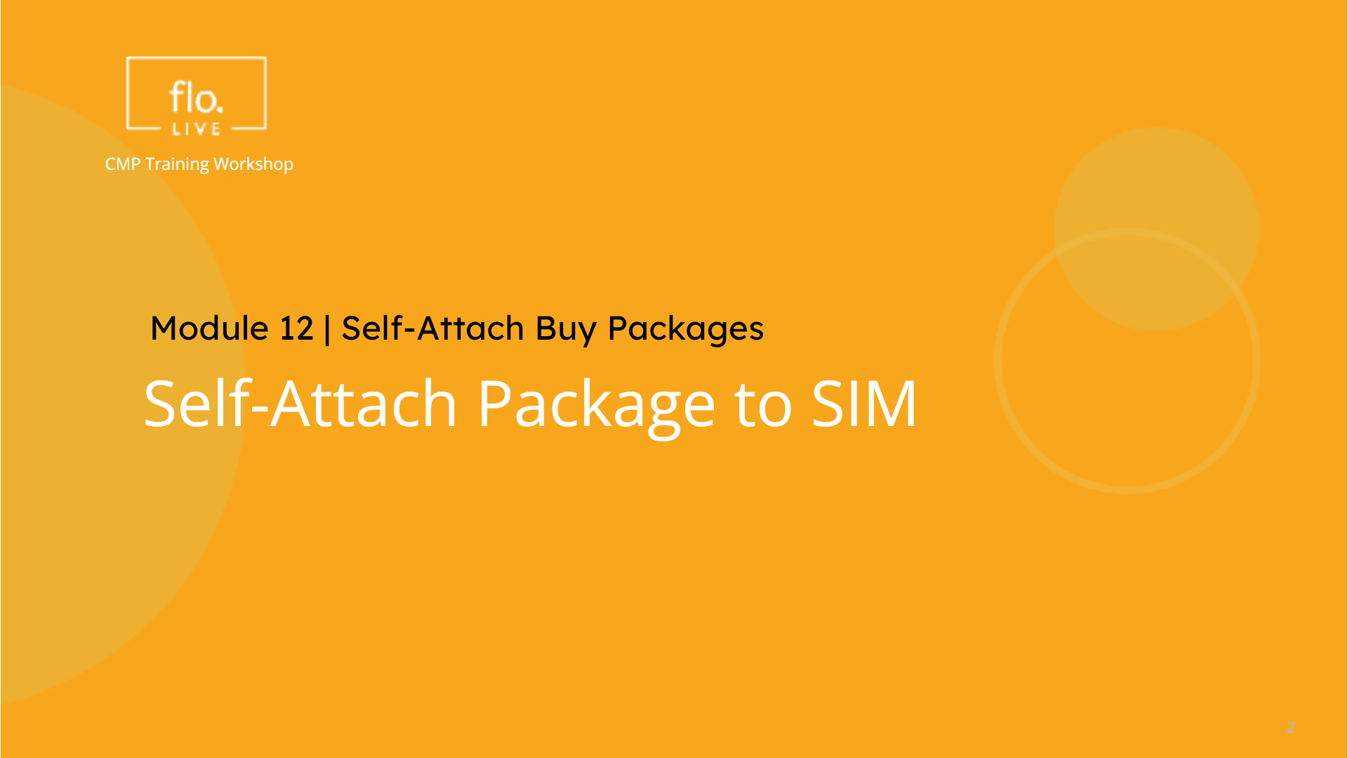
Notes:
Lets see how your sub-accounts can use the self-attach feature in the CMP Portal.

Slide 11
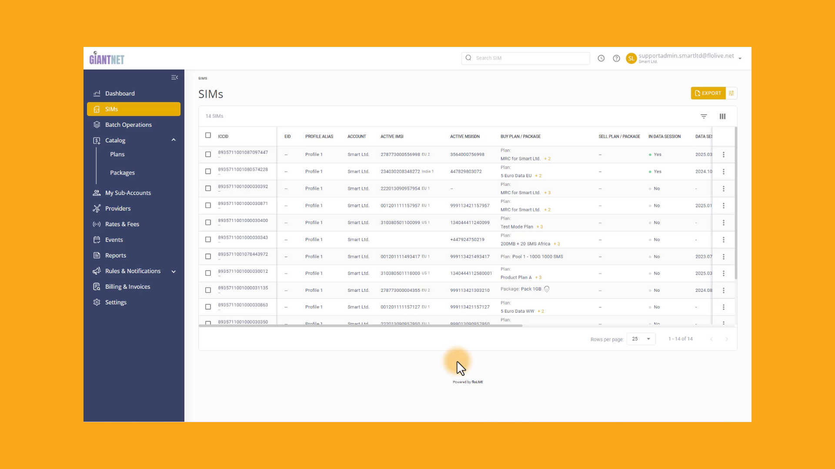
Notes:
First, select SIMs from the sidebar menu. Scroll the SIM table and select a SIM. . Click the Action menu on the right-side and select the Attach Replace Package option. Select the Buy Packages tab, Now attach one of the available packages to the selected SIM. Finally, click Attach to save your package settings.

Slide 12

Notes:
Thank you for watching this video tutorial. For more information about the CMP system, make sure you visit our Knowledge-base that is accessible directly from the CMP Portal.

